Slide 1

Semester 6 Overview
By Gabriel Antonio Zepeda

Slide 2
Table of Contents
Semester 6 Overview
Outcomes achieved during DAE
Success plan
Smart Goals
Weekly Schedule
Applying Daily
Upskilling

Slide 3

Semester 6 Overview

Slide 4


Overview
Overview
Deliverables
GitHub Contribution
GitHub Organization
Outcomes & Success Plan
Job application & Resume Building

Slide 5
Overview
How to contribute on GitHub
Pick a repository
Fork & Fix
Push and Pull
Find a cybersecurity repository
We fork, clone, and get to work on applying a fix or improvement
Now we push our branch, and submit a pull request for the owner to review.

Slide 6
Overview
H4X-Tool

Slide 7
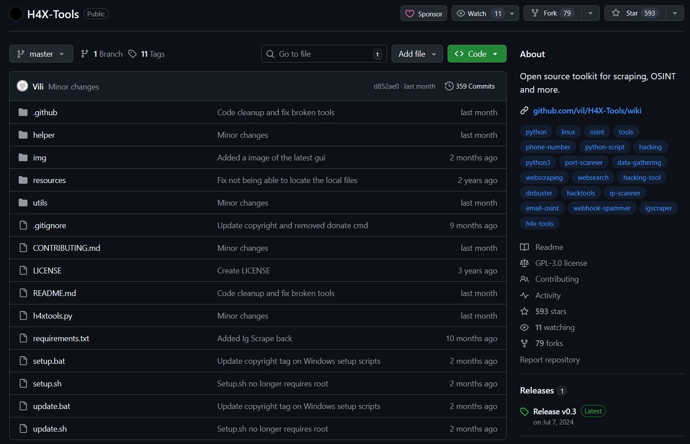
Overview

Slide 8
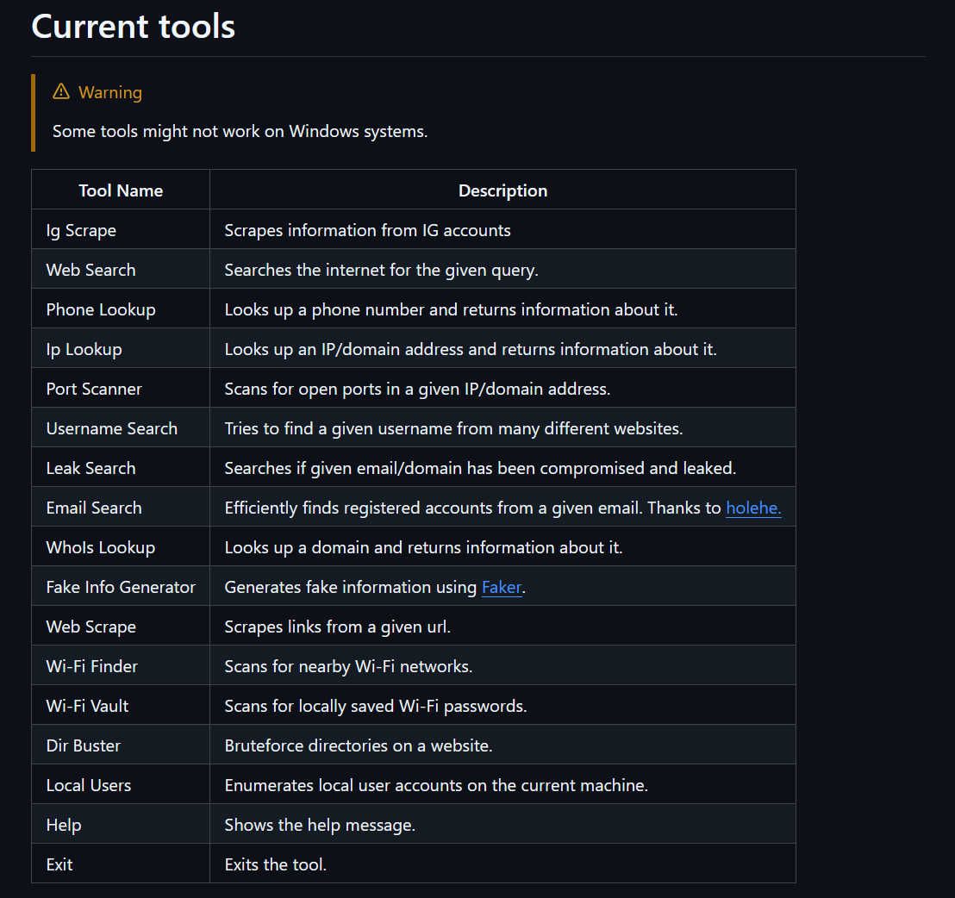
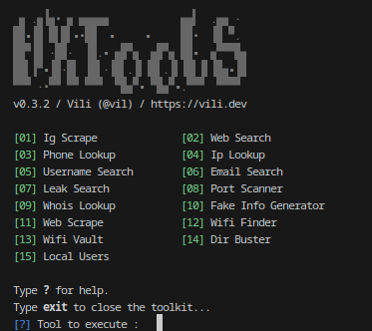
Overview

Slide 9
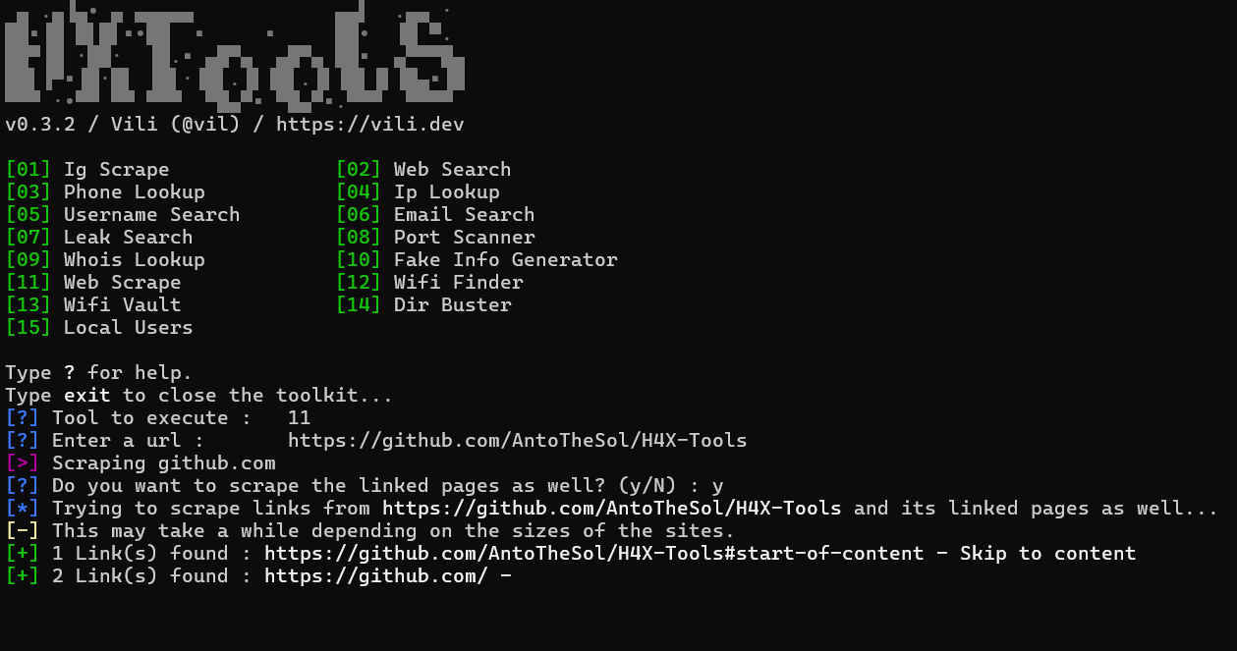
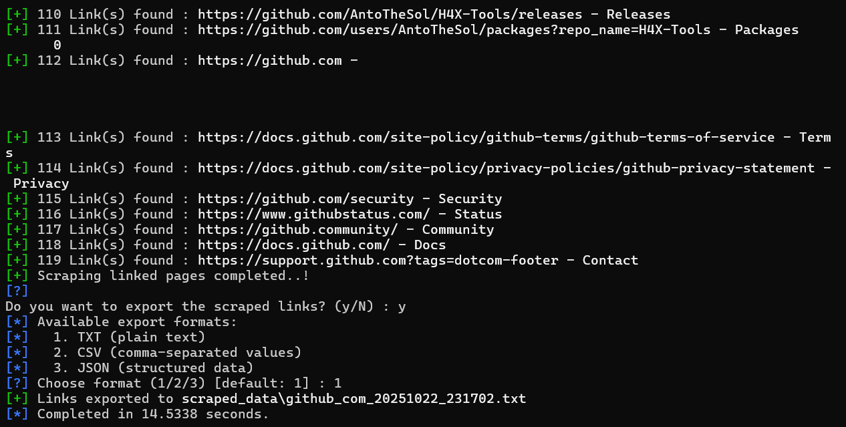
Overview

Slide 10
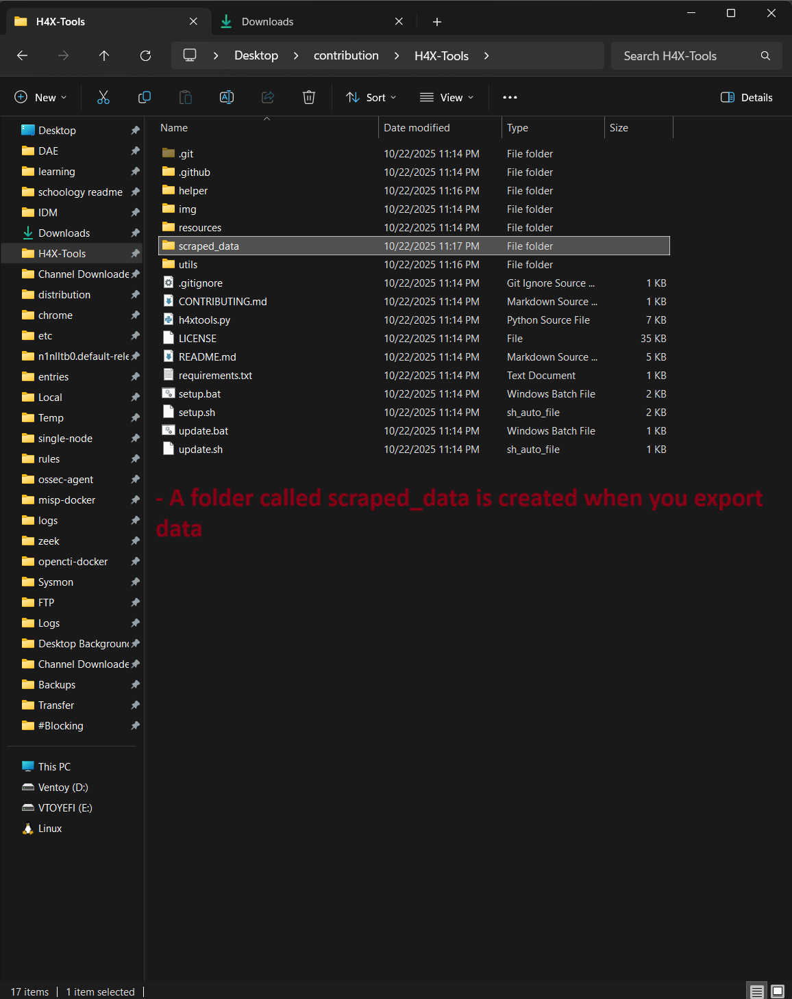
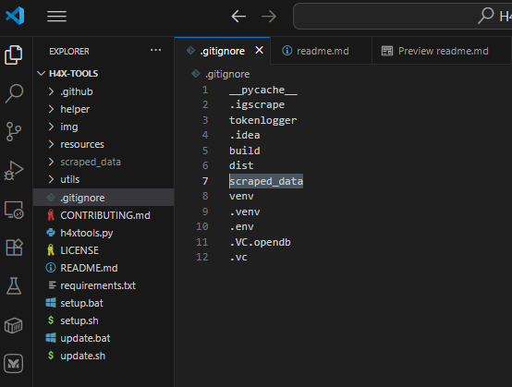
Overview

Slide 11
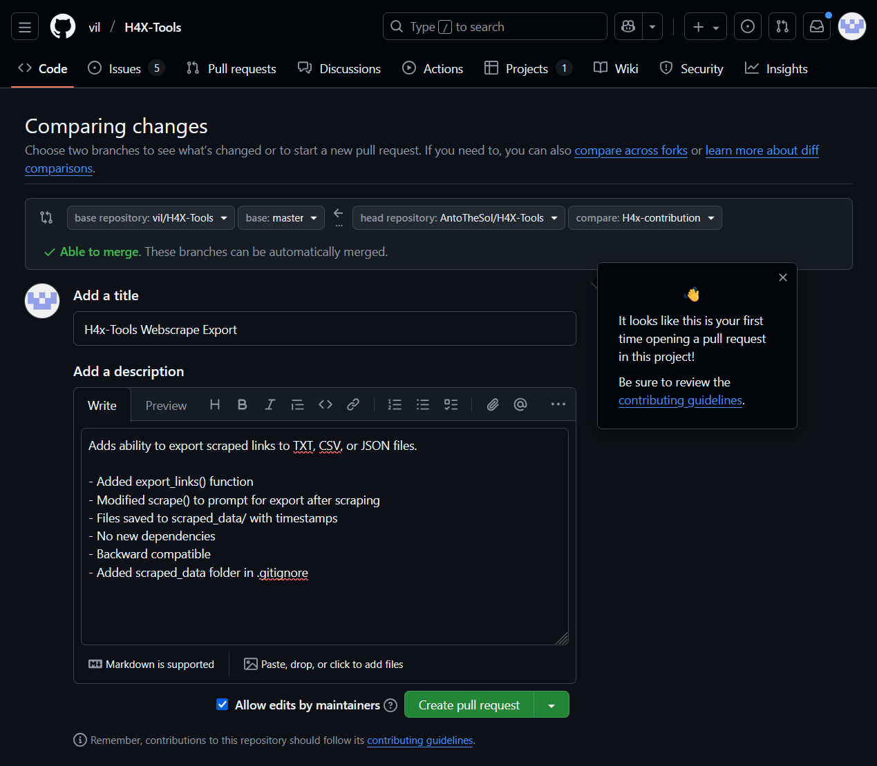
Overview

Slide 12
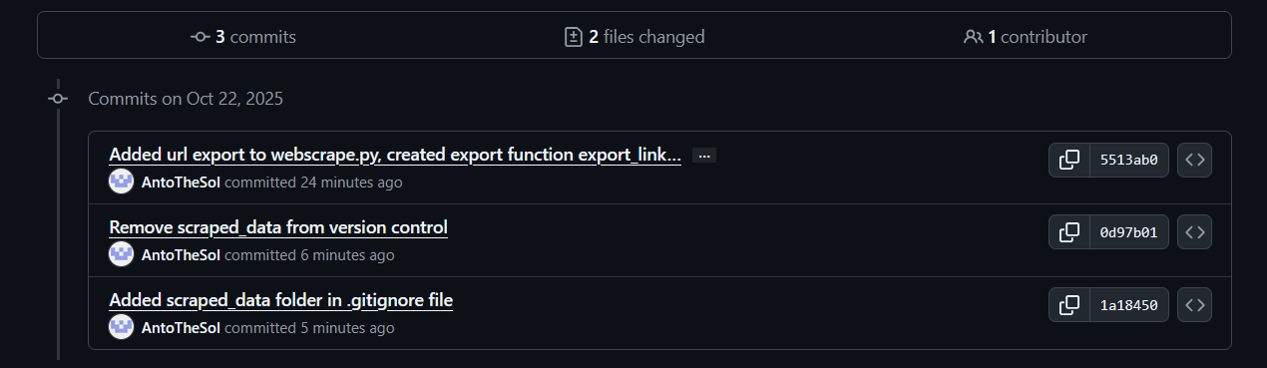
Overview

Slide 13
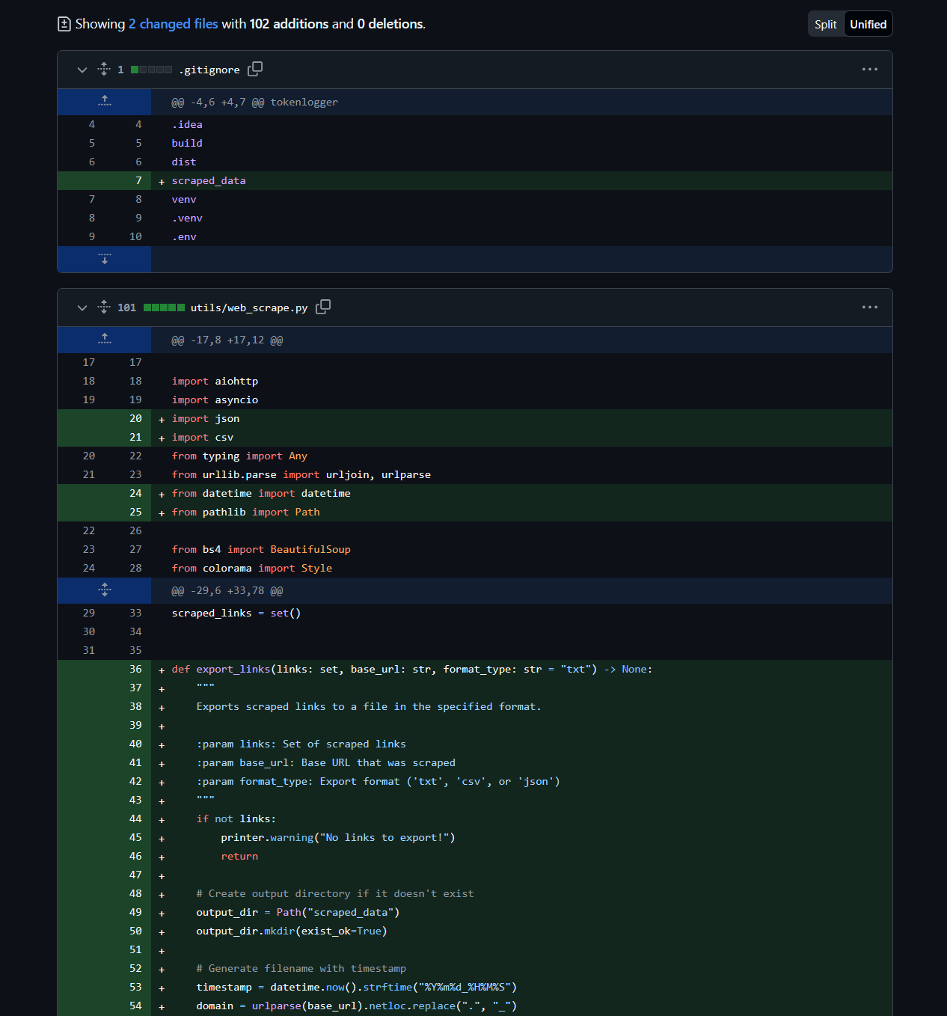
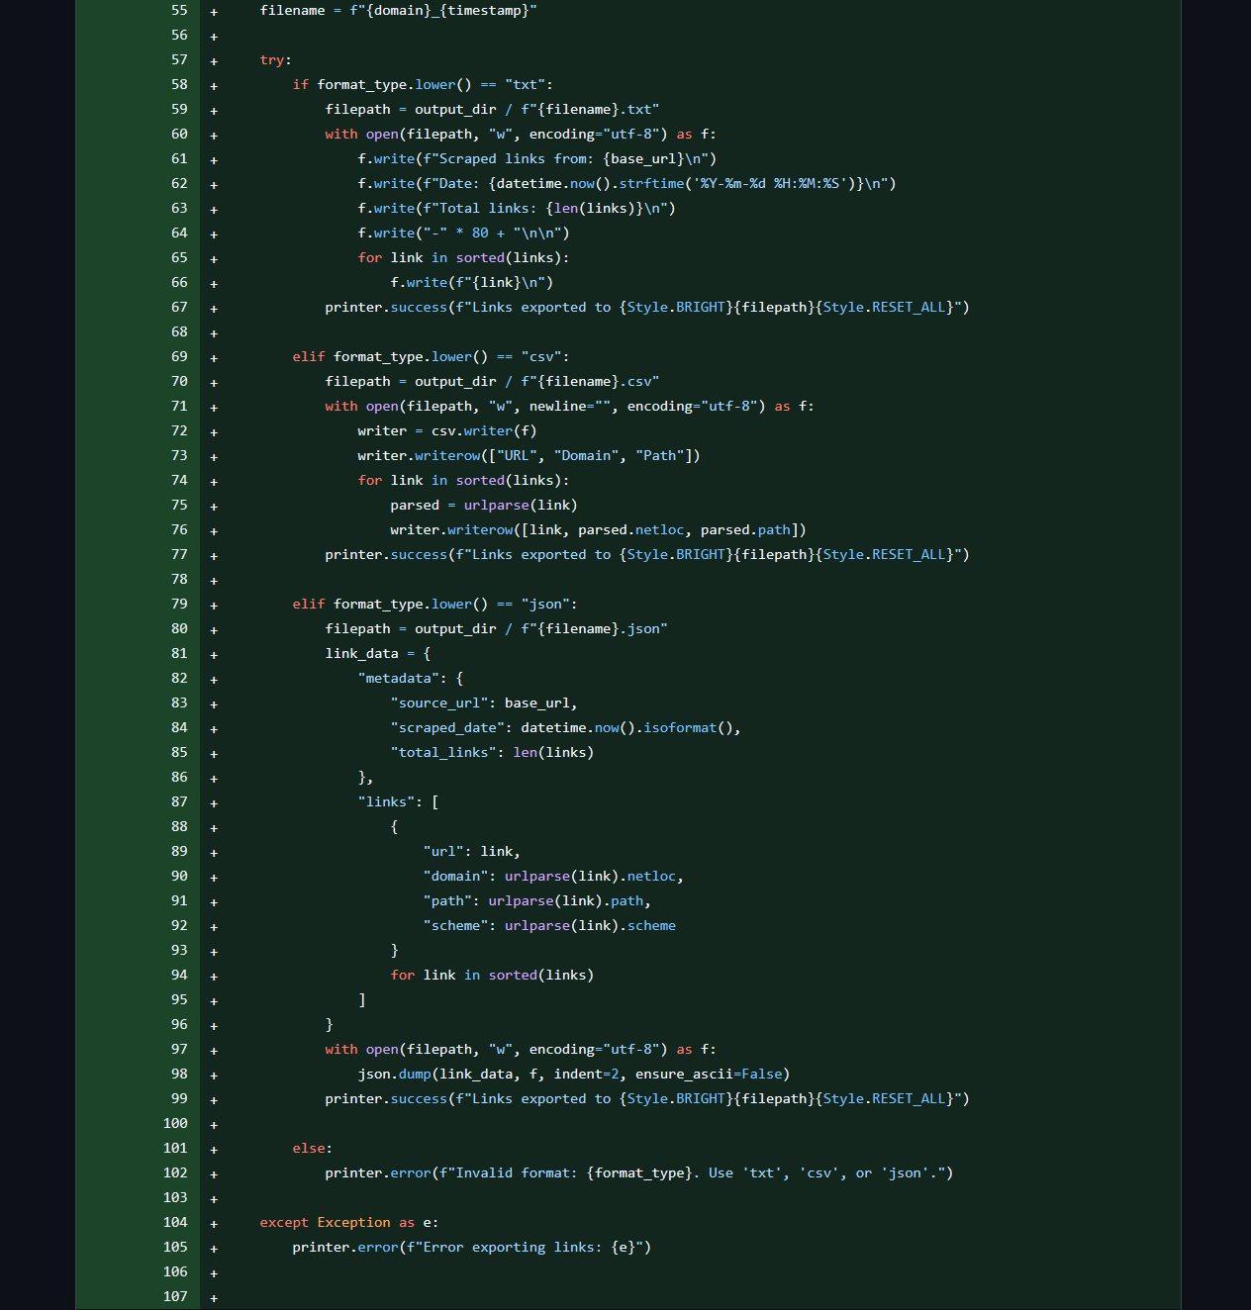
Overview

Slide 14
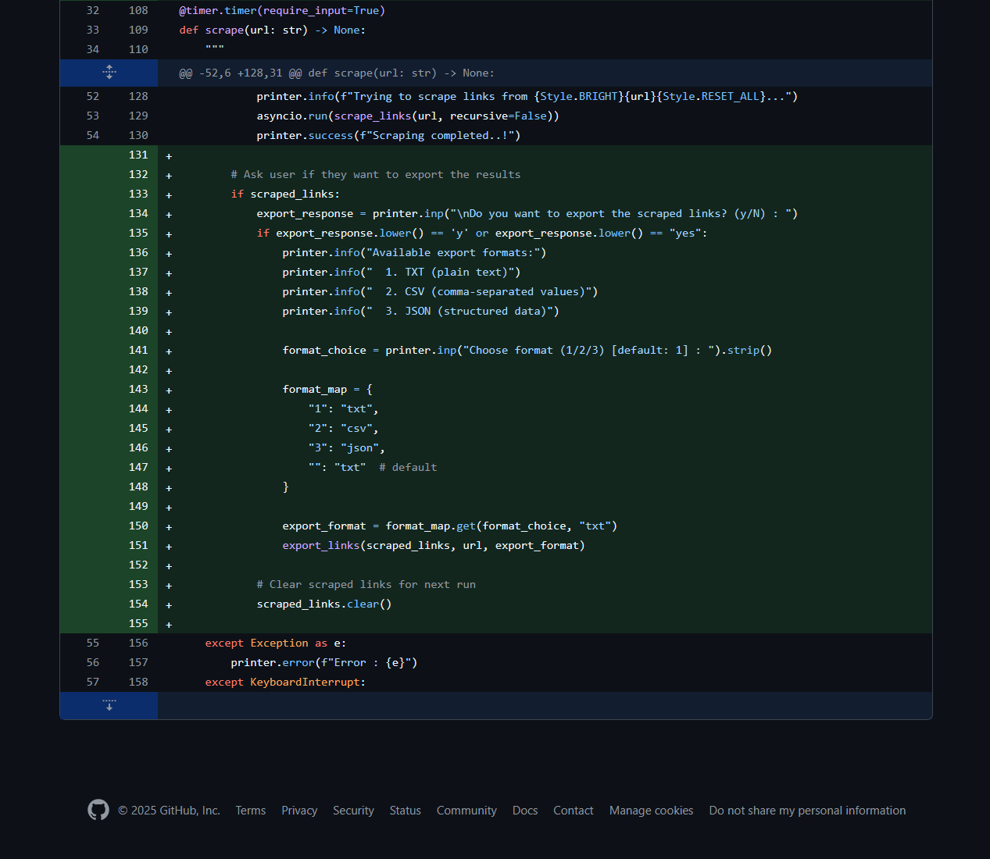
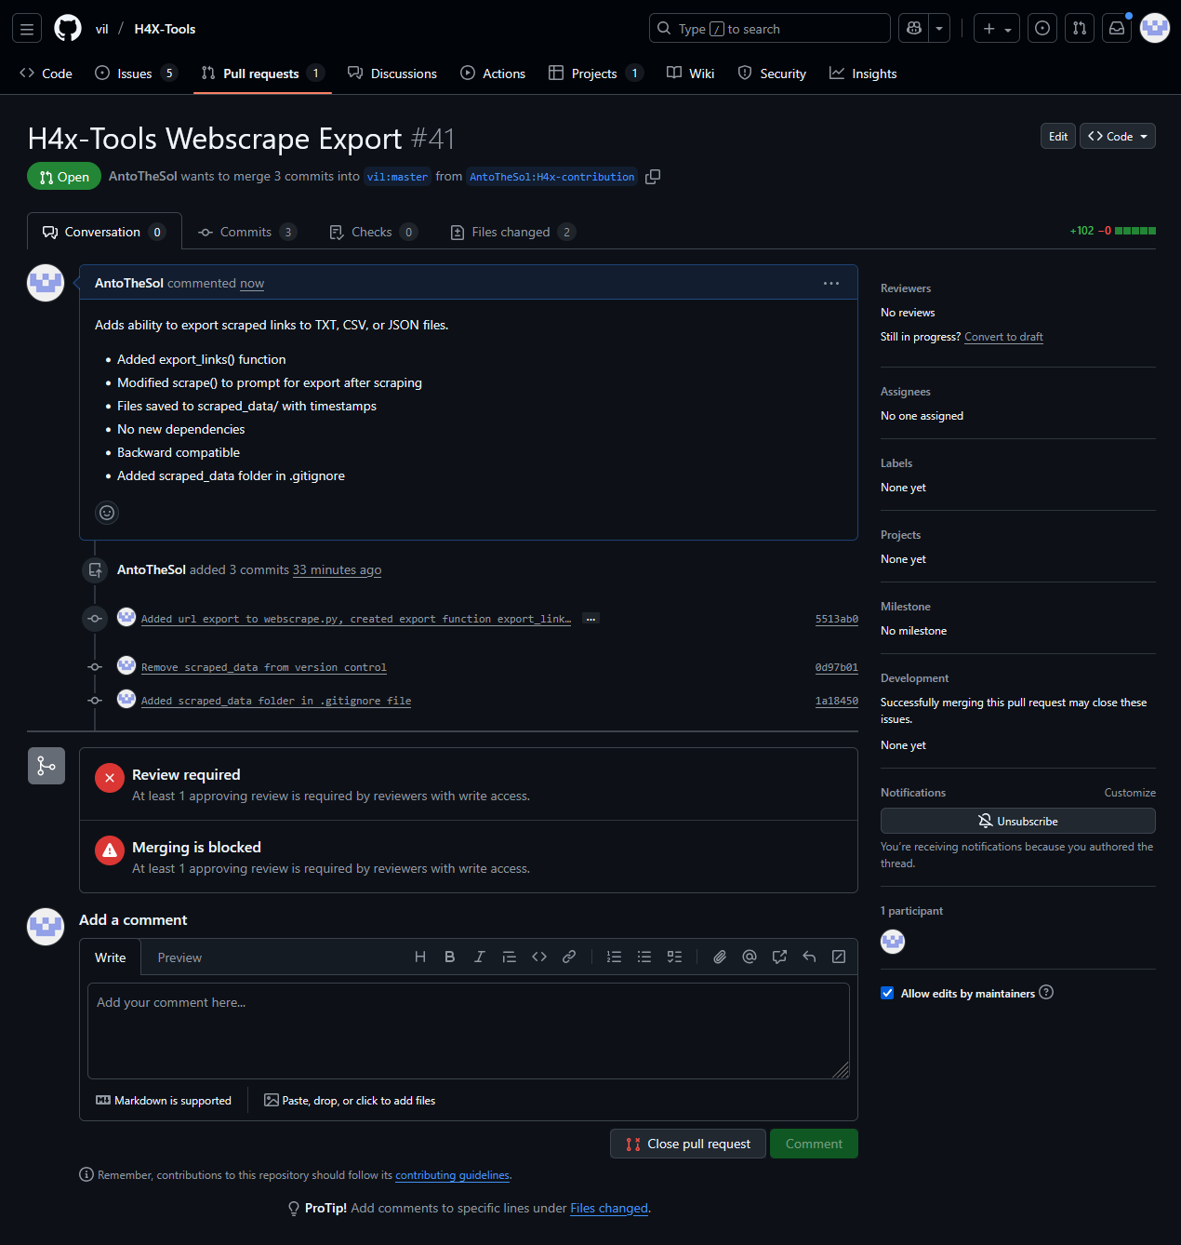
Overview

Slide 15
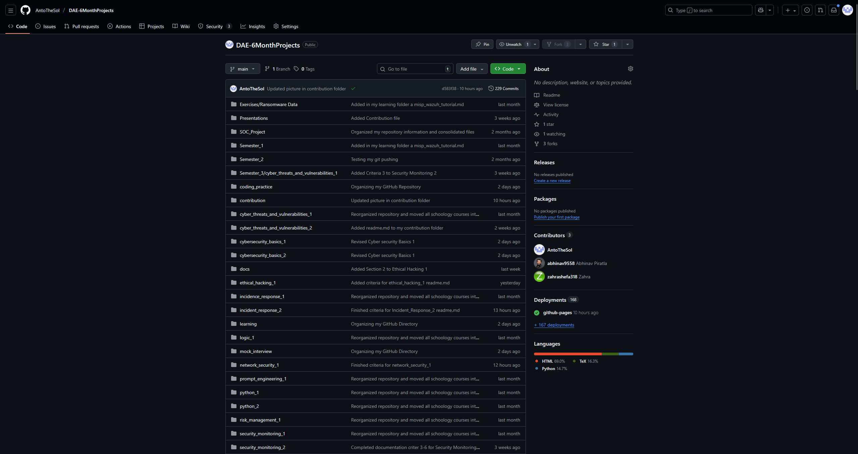
Overview
GitHub Organization

Slide 16
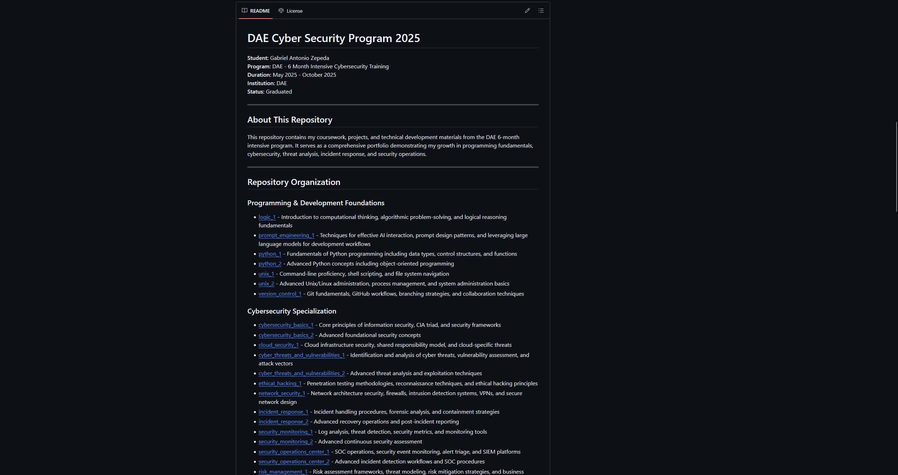
Overview
GitHub Organization

Slide 17
Overview
Outcomes

Slide 18
Outcomes
DAE Outcomes
Establishing skills necessary for entry level cyber security work
Understanding basic terminology and tool use ie. SIEM, IDS, Malicious software
Developing a foundational understanding of coding
Creating a polished portfolio on GitHub & GitHub pages
Building a professional resume and LinkedIn
Improving my soft skills ie. Presenting & team collaboration
SOC Virtual Lab

Slide 19
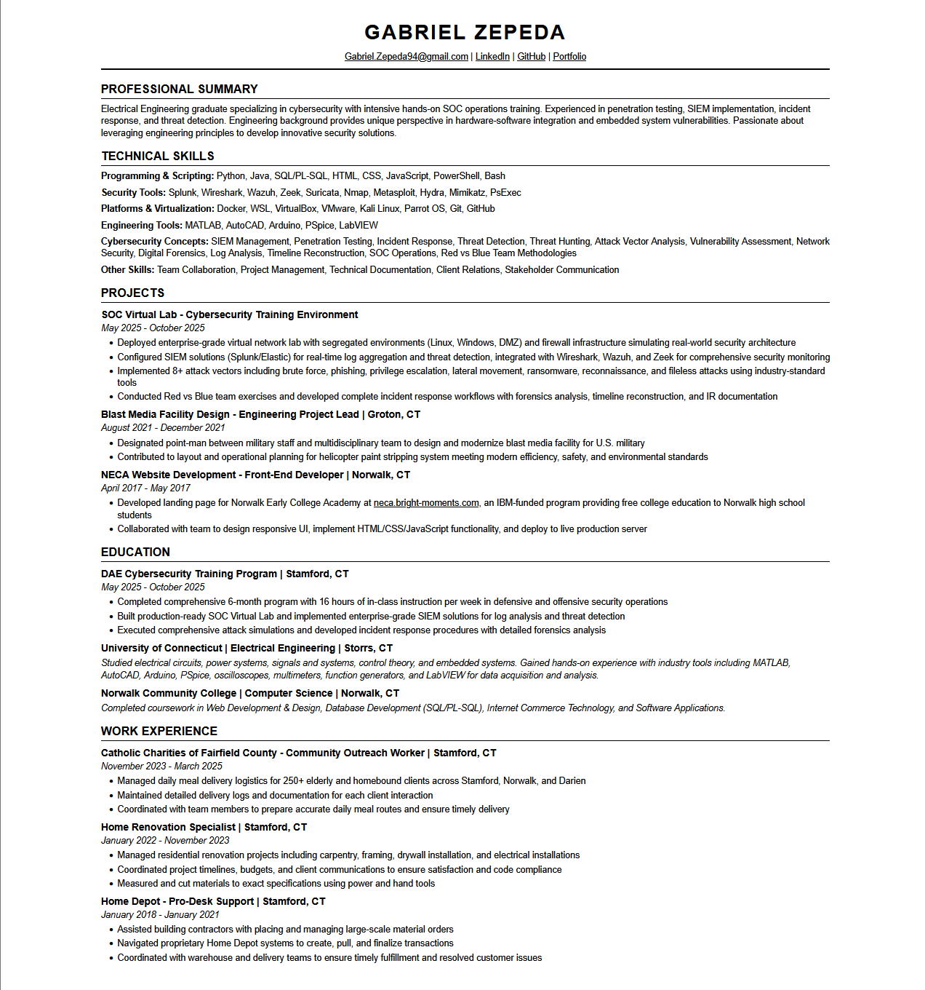
Outcomes

Slide 20

Outcomes
Smart Goals

Slide 21
Outcomes
Smart Goals
Presenting & Public Speaking - 1x month - Present a cyber security topic or walkthrough to peers/online community
Networking - 1x month - Attend a local cybersecurity meetup, conference, or virtual event
Organizational Skills - 1x week - Document and organize weekly learnings in a knowledge base or notes system
Time Management - Daily - Dedicate 1-2 hours to focused study/practice using a structured schedule
Project Building - 1x month - Creating a mini project to improve coding skills
Certificates - Every 3-4 months - Study and attempt certifications in order: CompTIA A+, Sec+, then BTL1
Tool Proficiency - 1x week - Practice with a key security tool (Wireshark, Nmap, Burp Suite, Metasploit, etc.)
Up skilling - 1x week - Complete a hands-on lab on TryHackMe, HackTheBox, or similar platform
Industry Awareness - 1x week - Read cybersecurity news and summarize 2-3 major threats or vulnerabilities

Slide 22

Thanks!
Thank You!

